Slide 1
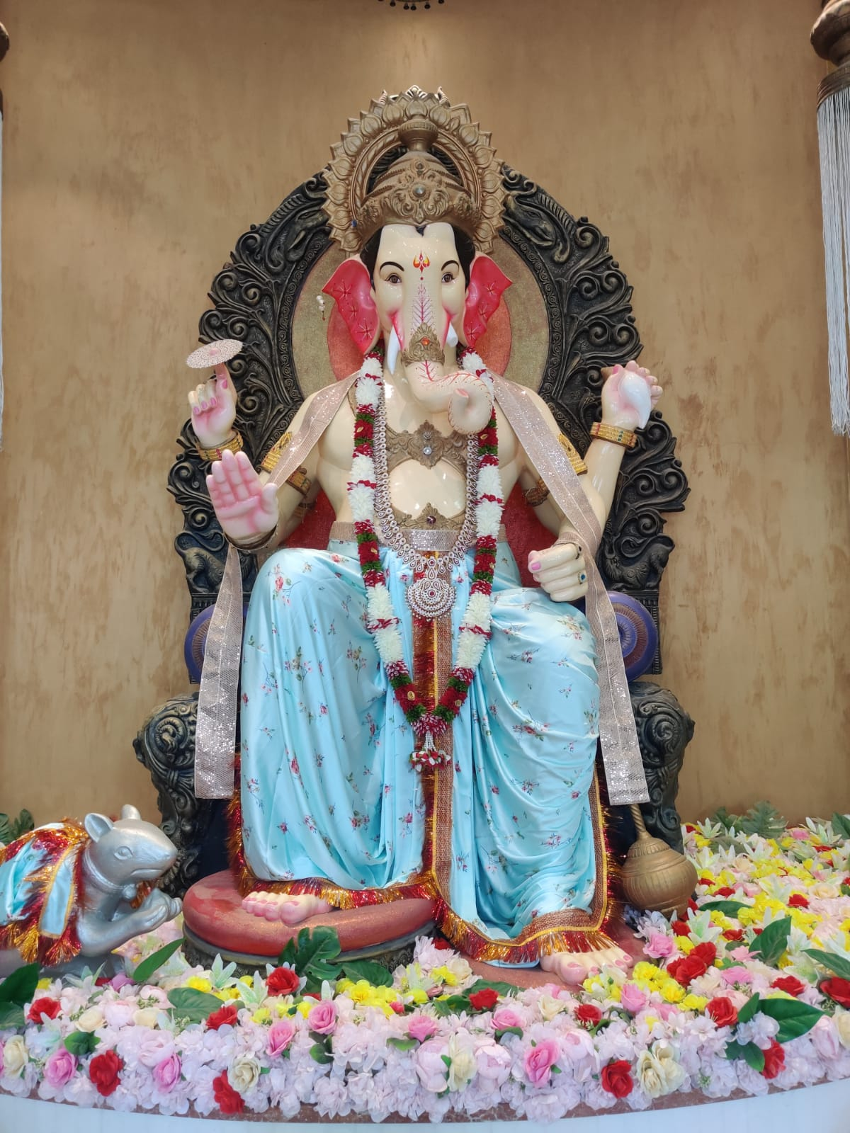

An Autonomous Institution
(Permanently Affiliated to VTU)
New Horizon Council for Innovation Incubation and Entrepreneurship (NHCIIE)
Established in 2001
Accorded Autonomous Status in 2015-16
151-200 band in NIRF 2023
Accredited by NAAC with “A” Grade
Accredited by NBA for all UG Programmes
Accorded “2f” Status by UGC

Slide 2

VISION
To create an entrepreneurial ecosystem among student, faculties management and staff, and propagate required support to stabilize real venture.
MISSION
To be committed towards facilitating entrepreneurship development by providing knowledge, mentoring, financial, technical, and non- technical and networking support to groom the pre-incubates, start-ups, first-generation entrepreneurs.
To strengthen the IIC in terms of students’ and teachers’ memberships, by motivating them through curricular component, promotional seminars and enthusing events.
To organize the MIC mandated annual series of events and activities such as Idea-Competition, B-Plan Competitions, Start-up fest, Hackathons, etc.
To establish and leverage the network of mentors, techpreneurs, investors, facilitators for the benefit of stakeholders of IIC.
To analyze, demonstrate and reward the success and failure stories of class of IIC-evolved entrepreneurs.
To promote integration of innovation and entrepreneurship into the curriculum to bring in attitudinal shift in faculty, students and staff.
Notes:
Links:
https://www.pexels.com/photo/cargo-container-lot-906494/

Slide 3
OBJECTIVES OF NHCIIE
To inculcate entrepreneurship among students, alumni and faculty members.
To create start-up ecosystem and align with policy initiatives of Make in India and Start-up India in our country.
To set up incubator facilities, and aid related to enhancing knowledge, mentoring, legal, financial, technological, intellectual property related to cost-effective infrastructural support and value- added services.
To foster the collaboration between student and faculties.
Speedy conversion of practice venture into real venture and commercializing the same.
To suggest strategic alliances with government, industry and financial institution.
To have a single start up policy for NHCE, under the umbrella of New Horizon Council for Innovation, Incubation, and Entrepreneurship (NHCIIE).
Notes:
Links:
https://www.pexels.com/photo/cargo-container-lot-906494/

Slide 4
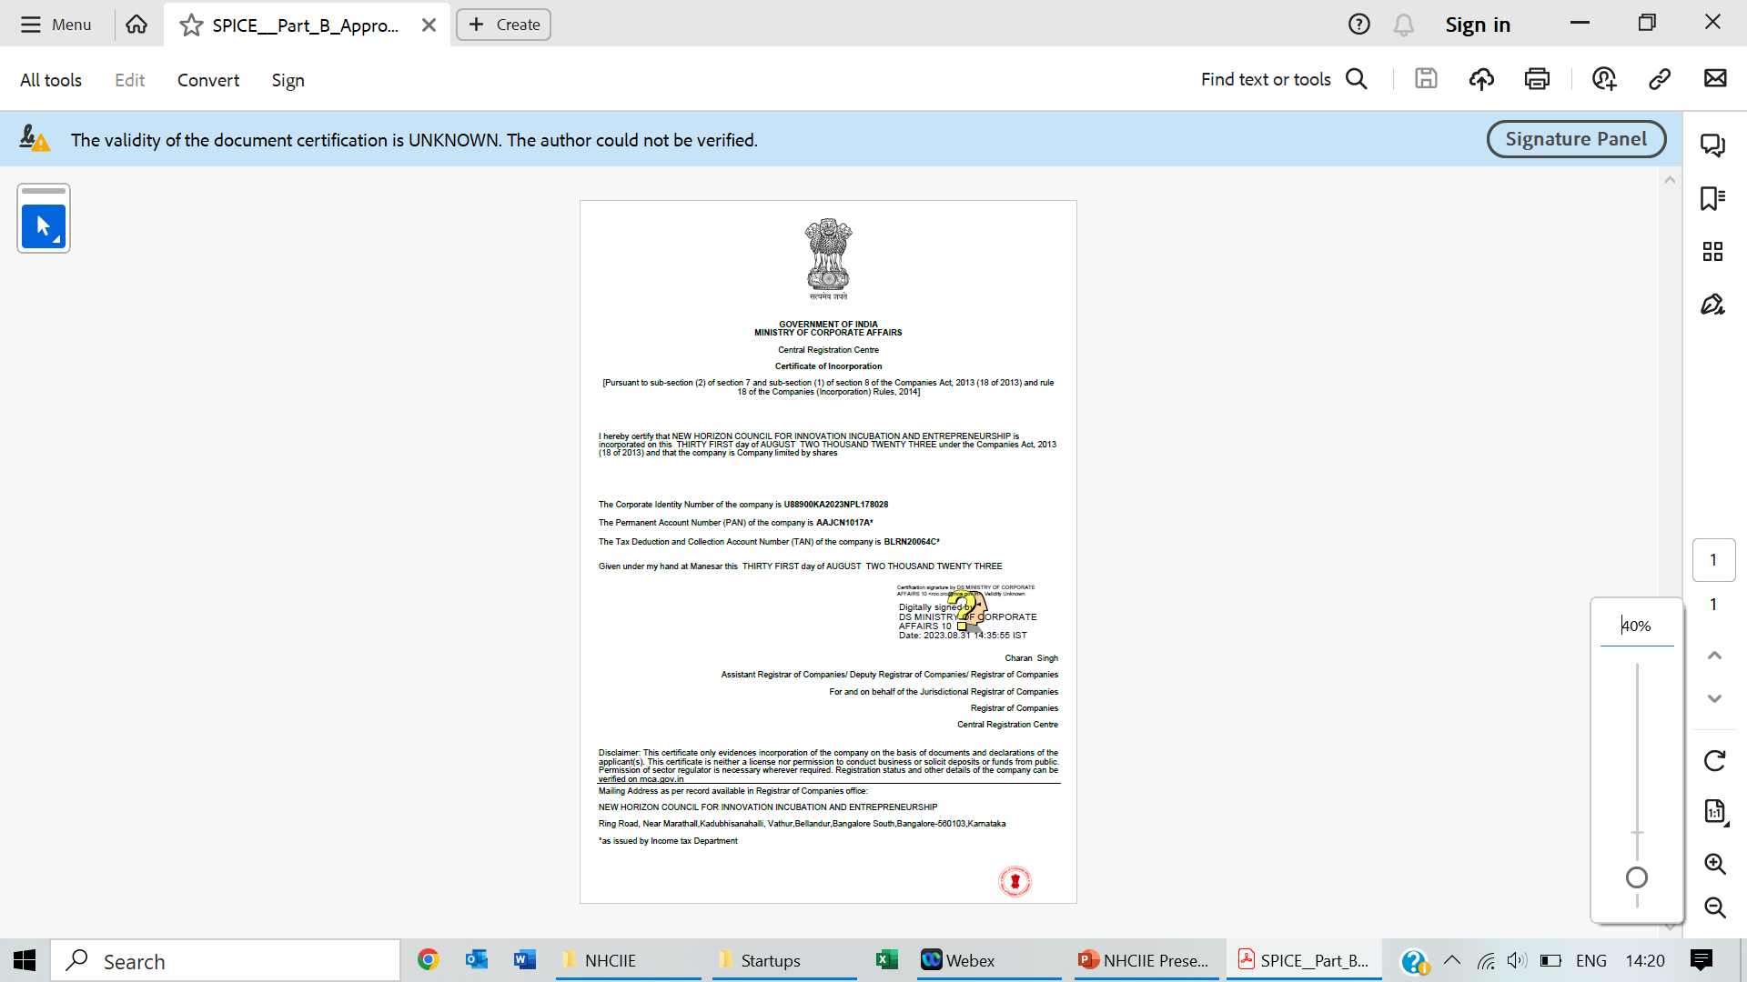
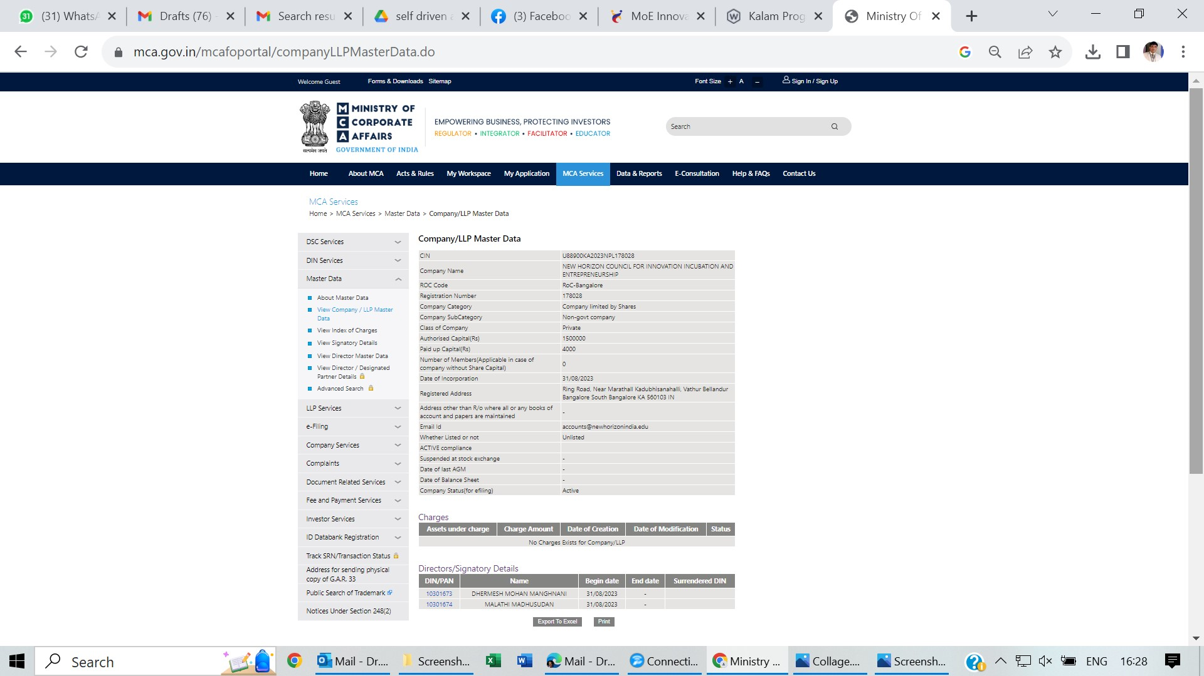
ABOUT US

Slide 5

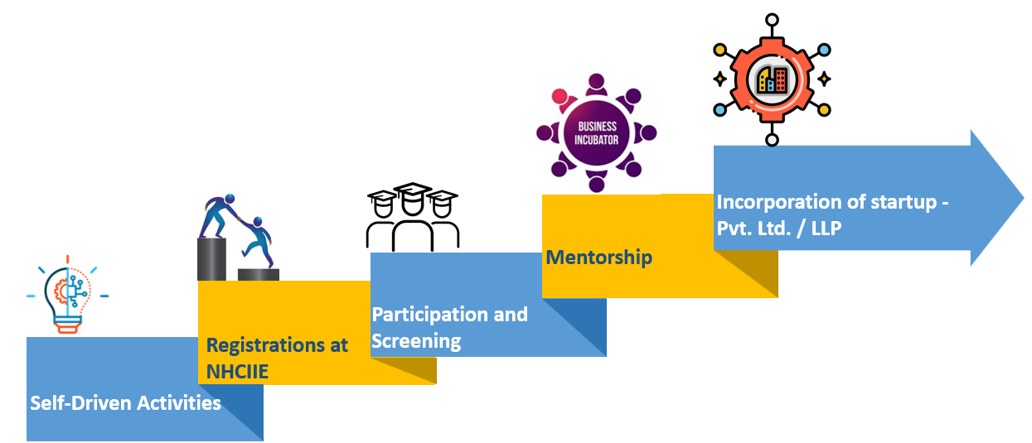
New Horizon Council for Innovation Incubation and Entrepreneurship (NHCIIE)

Slide 6
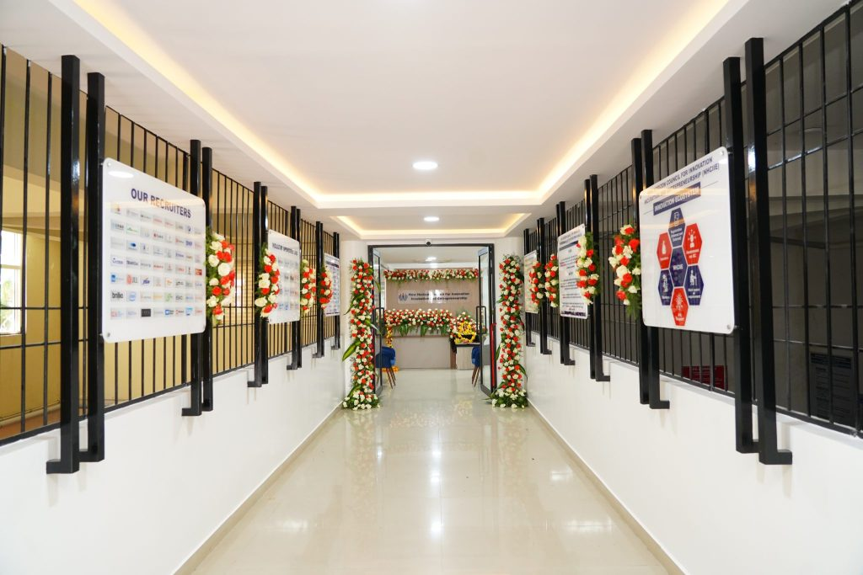
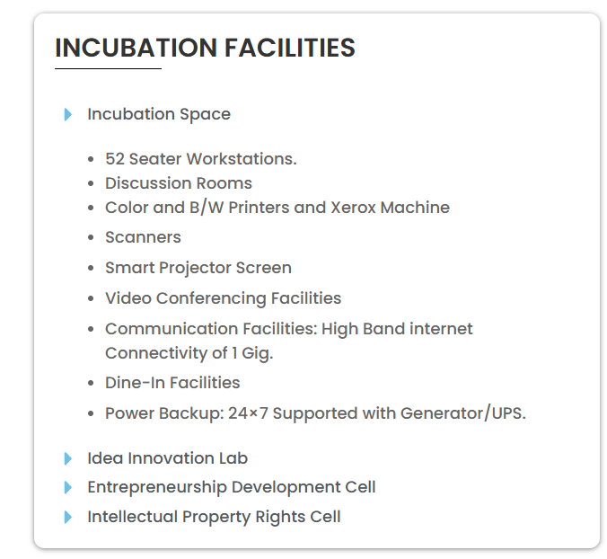
Innovation, Incubation & Entrepreneurship Cell Infrastructure

Slide 7
New Horizon Council for Innovation Incubation and Entrepreneurship (NHCIIE)
KEY-ACHIEVEMENTS
Under MathWorks Startup Program 10 Licenses of MATLAB worth | Rs. 10,00,000/-
Received Innovation Grant for KAPILA from the Ministry of Education’s Innovation Cell | Rs.5,44,000/-
Received Grant for Upskilling from IIT, Ropar | Rs. 2,00,000/-
Received Grants from AICTE under Student Innovation Council for IDE Bootcamp | Rs.18,50,000/-

Slide 8
Incubated Startups incorporated with
Ministry of Corporate Affairs (MCA), Government Of India
S. No. | Startup/Company Title | Year | Name of Student(s)
1 | WHISPULSE MESSENGER PRIVATE LIMITED [CIN: U62099KA2023PTC179182] | 2023 | JITHIN J NAIR, JAYANTH JEFFREY, JEFFREY JOHN (II Year, IV Sem, MBA, NHCE)
2 | SOFTKITCHEN INTERIO PRIVATE LIMITED [CIN: U74102KA2023PTC178387] | 2023 | SHREENIDHI KULKARNI (I Year, II Sem, MBA, NHCE) Mrs. JAYA KULKARNI (Mother of Mr. Shreenidhi Kulkarni)
3 | BLISSFULBRIDGES WELLNESS (OPC) PRIVATE LIMITED [CIN: U62099KA2023OPC178527] | 2023 | SAMMED SURENDRA UGARE (I Year, II Sem, MBA, NHCE)
4 | EQUIYKNOX PRIVATE LIMITED [CIN: U62099KA2023PTC178504] | 2023 | NANDISH MC, AKANKSH M, AKSHAY ACHARYA (I Year, II Sem, MBA, NHCE)
5 | RAMACHANDRA NAIDU JYOTHI PVT. LTD. (TURISST) [CIN U52291AP2024PTC113606] | 2024 | DOSAPATI AKSHAY (BE-ISE, III Year, VI Sem, NHCE)
6 | LEADONYX APEX LLP [LLPIN: ACH-5352] | 2024 | RAJ GOYAL, SOHAM SAMEER PATWARDHAN, REESHAV SINHA (BE-ISE, III Year, VI Sem, NHCE)
7 | ELYSIAN MOTORSPORTS PVT. LTD [ DIPP187910] | 2024 | ADRIAN DIAS (ALUMNI)
8 | GREYORM LLP [BLRG35068F ] | 2025 | GIRIRAJ TEJAS (BE-AIML, NHCE)
9 | STREET2SITE LLP [BLRS16847M ] | 2025 | BALARAJU SAUNTH BIBIN (PG-MCA,NHCE)

Slide 9





AUTONOMOUS COLLEGE, Permanently Affiliated to VTU, Approved by AICTE & UGC
Accredited by NBA and NAAC with ‘A’ Grade
---------------------------------------------------------------------------------------------------------------------------------------------------------------------------------------------------------------------------------------
New Horizon Knowledge Park, Bellandur Main Road, Near Marathahalli, Bangalore – 560103, Karnataka, India
CIN: U88900KA2023NPL178028
Memorandum of Understanding Signing Ceremony
I 28.12.2023

Slide 10

AUTONOMOUS COLLEGE, Permanently Affiliated to VTU, Approved by AICTE & UGC
Accredited by NBA and NAAC with ‘A’ Grade
----------------------------------------------------------------------------------------------------------------------------------------------------------------------------------------
New Horizon Knowledge Park, Bellandur Main Road, Near Marathahalli, Bangalore – 560103, Karnataka, India
CIN: U88900KA2023NPL178028
Memorandum of Understanding Signing Ceremony I 02.02.2024 l Friday

Slide 11

AUTONOMOUS COLLEGE, Permanently Affiliated to VTU, Approved by AICTE & UGC
Accredited by NBA and NAAC with ‘A’ Grade
----------------------------------------------------------------------------------------------------------------------------------------------------------
New Horizon Knowledge Park, Bellandur Main Road, Near Marathahalli, Bangalore – 560103, Karnataka, India
CIN: U88900KA2023NPL178028
Letter of Intent Signing Ceremony I 06.06.2024

Slide 12

AUTONOMOUS COLLEGE, Permanently Affiliated to VTU, Approved by AICTE & UGC
Accredited by NBA and NAAC with ‘A’ Grade
----------------------------------------------------------------------------------------------------------------------------------------------------------------------------------------
New Horizon Knowledge Park, Bellandur Main Road, Near Marathahalli, Bangalore – 560103, Karnataka, India
CIN: U88900KA2023NPL178028
Memorandum of Understanding Signing Ceremony I 08.06.2024 l Saturday

Slide 13

AUTONOMOUS COLLEGE, Permanently Affiliated to VTU, Approved by AICTE & UGC
Accredited by NBA and NAAC with ‘A’ Grade
----------------------------------------------------------------------------------------------------------------------------------------------------------------------------------------
New Horizon Knowledge Park, Bellandur Main Road, Near Marathahalli, Bangalore – 560103, Karnataka, India
CIN: U88900KA2023NPL178028
Memorandum of Understanding Signing Ceremony

Slide 14
AUTONOMOUS COLLEGE, Permanently Affiliated to VTU, Approved by AICTE & UGC
Accredited by NBA and NAAC with ‘A’ Grade
----------------------------------------------------------------------------------------------------------------------------------------------------------------------------------------
New Horizon Knowledge Park, Bellandur Main Road, Near Marathahalli, Bangalore – 560103, Karnataka, India
ELYSIAN MOTORSPORTS PRIVATE LIMITED
CIN: U88900KA2023NPL178028
Memorandum of Understanding Signing Ceremony

Slide 15
New Horizon Council for Innovation Incubation and Entrepreneurship (NHCIIE)
KEY-HIGHLIGHTS:
Incubated 10 Student Startups
Incubated 02 Corporate startups, namely Cientra TechSolution Pvt. Ltd. and YellowStone EV Power Pvt. Ltd.
I&E Collaborations: 1. Cientra, 2. Honeywell, 3. CII-Young Indians, 4. StemX, 5. Softkitchen Interio.
30 ideas shortlisted to MSME Idea hackathon 5.0
No. of Startup Ideas Registered at NHCIIE = 37
(33 NHCE Student Teams, 01 NHPS Student, 01 NHG Student, 01 NHCK Student Team,01 NHCM Student)
Received 10 lakhs worth MATLAB License from MathWorks under MathWorks Startup Program
278 student teams(1500 Student) participated in the Internal Hackathon for SIH– 2025 held dt. 13th Sept 2025.
11 Innovation and Entrepreneurship Activities conducted as Self-driven Activities for NHCE students and faculty members.

Slide 16

New Horizon Council for Innovation Incubation and Entrepreneurship (NHCIIE)

